Slide 1
Brick: Towards a Unified Metadata Schema For Buildings
http://brickschema.org/

Slide 2
A Vision for “Smart Buildings”
Applications
Demand Response
Occupant Interaction
NILM
Occupancy Models
Predictive Control
Fault Detection
Management Services
APIs
Data Storage
Access Control
Monitoring
Search
Privacy
Buildings
Home
Office
Factory
Research Lab
Hospital
Shopping Mall
Infrastructure: Sensors Equipment
Smoke Detector
Thermostat
Motion Sensor
Fire Safety
HVAC
Lighting

Slide 3
Data From Buildings Faces Significant Challenges in Integration
Apps need to understand building metadata
Location of sensors and equipment
How equipment connect with each other
Configuration parameters of control systems
But metadata not consistent or machine readable
E.g. “Temperature” -> “Temp”, “Temporary” -> “Temp”
Metadata varies with building, vendor, type of system
Temperature sensor as an example
What? -> air, water
Where? -> room, exhaust, refrigerator
How is it used? -> control system, fault
Notes:
- Every building has thousands of data points, each of which come from various sensors, equipment
- Metadata for these data points are inconsistent, not machine readable and varies with vendor and usage culture
- Infrastructure configuration varies widely across different types of buildings, weather conditions and vendor
- Illustrate with examples

Slide 4
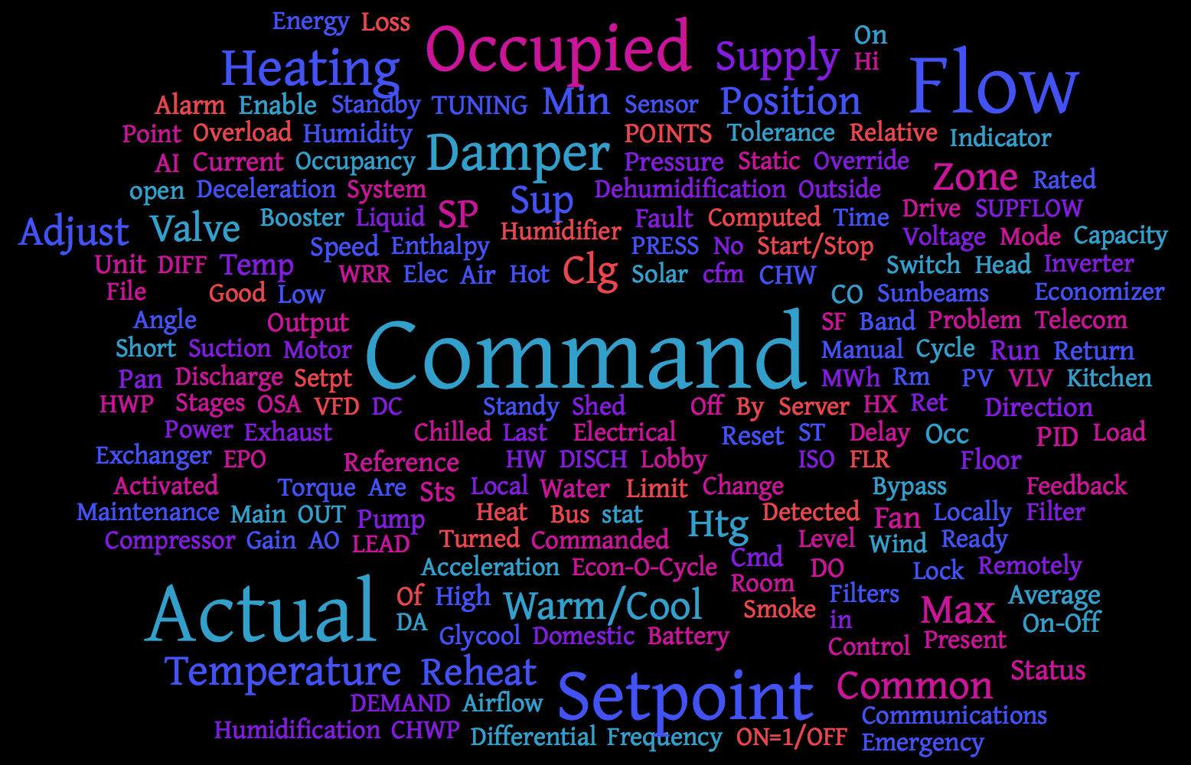
Metadata For An Existing Building
Source: EBU3B building at UCSD, built in 2004. Word cloud limited to 200 most frequent words

Slide 5
We Need a Metadata Schema
Applications
Demand Response
Occupant Interaction
NILM
Occupancy Models
Predictive Control
Fault Detection
Management
APIs
Data Storage
Access Control
Monitoring
Search
Privacy
Metadata Schema
Buildings
Home
Office
Factory
Apartment
Hospital
Shopping Mall
Infrastructure: Sensors Equipment
Smoke Detector
Thermostat
Motion Sensor
Fire Safety
HVAC
Lighting

Slide 6
Existing Schema Are Inadequate
 | BIM/IFC
Domain | Construction
Coverage | Architecture, Mechanical, Electrical Design
Data Model | EXPRESS
Limitation | Lack of sensors, equipment

Slide 7
Existing Schema Are Inadequate
 | BIM/IFC | SAREF, SSN
Domain | Construction | Smart Appliances, Sensor Networks
Coverage | Architecture, Mechanical, Electrical Design | Location, Appliance, Sensors
Data Model | EXPRESS | Semantic Ontology
Limitation | Lack of sensors, equipment | Limited vocabulary

Slide 8
Existing Schema Are Inadequate
 | BIM/IFC | SAREF, SSN | Haystack
Domain | Construction | Smart Appliances, Sensor Networks | Building Management
Coverage | Architecture, Mechanical, Electrical Design | Location, Appliance, Sensors | HVAC, Lighting, Weather, Sensors, Points
Data Model | EXPRESS | Semantic Ontology | Tags
Limitation | Lack of sensors, equipment | Limited vocabulary | Inadequate tooling, limited relationships

Slide 9
Existing Schema Are Inadequate
Bhattacharya, Arka, Joern Ploennigs, and David Culler. "Short Paper: Analyzing Metadata Schemas for Buildings: The Good, the Bad, and the Ugly." BuildSys, 2015.

Slide 10
Collaborative Solution to a Common Problem
Limitations of existing schema
Informal Workshop at Berkeley
Open Source Release & Demo
Feb ‘16
Jun ‘16
BuildSys’15
Collaboration initiation
May ‘16
BuildSys Deadline
BuildSys ‘16

Slide 11
Bharathan Balaji, UCLA
Arka Bhattacharya, UC Berkeley
Gabriel Fierro, UC Berkeley
Jingkun Gao, CMU
Joshua Gluck, CMU
Dezhi Hong, UVA
Aslak Johansen, SDU
Jason Koh, UCSD
Joern Ploennigs, IBM
Yuvraj Agarwal, CMU
Mario Berges, CMU
David Culler, UC Berkeley
Rajesh Gupta, UCSD
Mikkel Kjaergaard, SDU
Mani Srivastava, UCLA
Kamin Whitehouse, UVA

Slide 12



Slide 13
Brick: Building Metadata Schema
Applications
Demand Response
Occupant Interaction
NILM
Occupancy Models
Predictive Control
Fault Detection
Management
APIs
Data Storage
Access Control
Monitoring
Search
Privacy
Brick
Buildings
Home
Office
Factory
Apartment
Hospital
Shopping Mall
Infrastructure: Sensors Equipment
Smoke Detector
Thermostat
Motion Sensor
Fire Safety
HVAC
Lighting

Slide 14
Brick: Building Metadata Schema
Applications
Demand Response
Occupant Interaction
NILM
Occupancy Models
Predictive Control
Fault Detection
Management
APIs
Data Storage
Access Control
Monitoring
Search
Privacy
Brick
Completeness: Capture all sensors/subsystems
Expressiveness: Capture relationships to run applications
Usability: Easy to understand, easy to map buildings

Slide 15
Outline
Why do we need Brick?
Brick
Basics
Development
Results
Moving forward

Slide 16
Outline
Why do we need Brick?
Brick
Basics
Development
Results
Moving forward

Slide 17
Brick is a Graph of Building Entities

Slide 18
What Does Brick Contain?
Buildings
Tags, Tagsets
Class Hierarchy
UCSD
IBM, Ireland
CMU
Relationships
Brick

Slide 19

An Example “Model” Building
Lighting Controller
AHU
Power Meter
Lighting Zone
Return Fan
Supply Fan
VAV
Damper
Return Air
Supply Air
Room 101
Room 102
Thermostat Temperature CO2 Sensor
HVAC ZONE

Slide 20
Brick is a Graph of Building Entities
Lighting
Controller
AHU
Lighting
Zone
VAV
Room 2
Room 1
Temperature Sensor
We choose to model this graph using ontologies
Alternatives: Verilog, IFC

Slide 21
Tagsets: Brick Entities
Tagsets

Slide 22
Tagsets and Tags
Tagsets: Building entities described in Brick
“Zone Temperature Sensor”
“Zone CO2 Sensor”
“Room”
“Air Handler Unit” (also called “AHU”)
Tags: Decomposition of tagsets
“Zone Temperature Sensor” -> “Zone” “Temperature” “Sensor”
Tags facilitate annotation and keyword search
Tagsets facilitate semantic modeling
Thermostat Temperature CO2 Sensor

Slide 23
Tagsets are Organized in a Hierarchy
Location
Building
Room
Conference Room
HVAC Zone
Lighting Zone
…
Equipment
Fire Safety System
HVAC
AHU
Fan
Supply Fan
Thermostat
…
Point
Alarm
Command
Damper Command
Sensor
Temperature Sensor
Setpoint
Temperature Setpoint
…

Slide 24
Relationships Link Tagsets
hasLocation
isPartOf, feeds
Location
feeds
Equipment
hasLocation
Legend
isPointOf, hasLocation
isPointOf, isPartOf
Class
Relationship
Point
Essential to capture linkages between entities

Slide 25
Relationships in Example Building
Power Meter
hasPoint
AHU
AHU
Power Meter
feeds
HVAC Zone
feeds
VAV
Return Fan
Supply Fan
VAV
hasPart
Damper
Damper
Designed to capture essential aspects in BMS
Restrictions to avoid misuse: “hasLocation” limited to Location tagsets

Slide 26
Relationships in Example Building
Lighting Controller
Power Meter
hasPoint
AHU
controls
feeds
Lighting Zone
isLocationOf
HVAC Zone
feeds
VAV
isLocationOf
hasPoint
isLocationOf
hasPoint
hasPart
Room 102
Room 101
Temperature Sensor
Damper
Legend
Relationship
Location
Equipment
Point

Slide 27
Function Blocks
VAV
VAV
Damper
VAV
Damper
Zone Temperature
hasPoint
feeds
Temperature
Setpoint
Air Flow Setpoint
Damper Command
Damper Position
Air Flow
controls
controls
affects
AHU Supply Temperature
controls
Enables modularity, encapsulation, reusability
Library of function blocks to ease development

Slide 28
Machine Readable & Queryable
Triples as data format
subject predicate object
Every entity is a URL brick: <http://buildsys.org/ontologies/Brick#>
example:Berg_Hall rdf:type brick:Room example:Light hasLocation example:Berg_Hall
SPARQL for querying
Pattern matches across the graph
SELECT ?temp WHERE { ?temp rdf:type brick:Temperature_Sensor }

Slide 29
Outline
Why do we need Brick?
Brick
Basics
Development
Results
Moving forward

Slide 30
Empirical Methodology
Six Buildings
Eight Representative Applications
UCSD
UC Berkeley
Model Predictive Controls
Occupancy Modeling
Demand Response
SDU
UVA
Energy Apportionment
Participatory Feedback
CMU
IBM, Ireland
Fault Detection
Web Displays
NILM
17700 points, 630000 sqft.

Slide 31
Iterative Development Process
Buildings
Tags, Tagsets
Class Hierarchy
UCSD
IBM, Ireland
CMU
Relationships
Brick

Slide 32
Iterative Development Process
Ground Truth Metadata
Map Building Metadata
to Brick
SPARQL for Apps
UCSD
IBM, Ireland
Brick
CMU
UC Berkeley
UVA
Coverage: 93.2%

Slide 33
Outline
Why do we need Brick?
Brick
Basics
Development
Results
Moving forward

Slide 34
Coverage Across Buildings
Building | UCSD | CMU | IBM | UVA | Berkeley | SDU
Coverage | 96% | 99% | 99% | 98.5% | 98.7% | 98.8%

Slide 35
App Query Matches for Buildings
 | UCSD | SDU | CMU | IBM | UVA | Berkeley
Occupancy
Energy Apportionment
Web Displays
MPC
Participatory Feedback
Fault Detection
NILM
Demand Response

Slide 36
Live Demo

Slide 37
Brick vs Haystack
HVAC
Haystack
Brick
Id: TS
TS is a Temperature Sensor
TS hasLocation Room
TS isPointOf VAV
Floor
AHU
temp
point
sensor
Room
VAV
roomRef
floorRef
vavRef
Temperature Sensor: TS
ahuRef
hvac

Slide 38
Brick vs Haystack
 | Brick | Haystack

Slide 39
Brick vs Haystack
 | Brick | Haystack
Reference Implementation | 6 buildings, 8 applications | None

Slide 40
Brick vs Haystack
 | Brick | Haystack
Reference Implementation | 6 buildings, 8 applications | None
Relationships | Captures relationships within and across subsystems | Can link entities, but does not classify relationships

Slide 41
Brick vs Haystack
 | Brick | Haystack
Reference Implementation | 6 buildings, 8 applications | None
Relationships | Captures relationships within and across subsystems | Can link entities, but does not classify relationships
Querying | SPARQL queries that traverse Brick graph | Restrictive query, cannot traverse relationships

Slide 42
Brick vs Haystack
 | Brick | Haystack
Reference Implementation | 6 buildings, 8 applications | None
Relationships | Captures relationships within and across subsystems | Can link entities, but does not classify relationships
Querying | SPARQL queries that traverse Brick graph | Restrictive query, cannot traverse relationships
Encapsulation | Functional blocks encapsulate complex subsystems | No modularity

Slide 43
Outline
Why do we need Brick?
Brick
Basics
Development
Results
Moving forward

Slide 44
Lessons Learned
Mapping buildings to Brick
Semi-automated mapping: 5 papers in BuildSys 2015
New types of building and equipment
Update building tagsets
An unknown sensor can be referred to as “Sensor”
Separation of application from building infrastructure
Application specific terms should not be part of Brick

Slide 45
Moving Forward: Call to Action!
Open Sourced with BSD license
http://brickschema.org/
Sustained improvements, extensions:
Comments, issue tracking, pull requests on github
Integrate with building management systems
We have an initial integration with BuildingDepot
Compatibility with IFC
Exploit IFC “adapters” to convert CAD specs to Brick
Brick in Practice
Usability testing, performance evaluation, tool-chain support

Slide 46
Thank You!
Visit our Demo!
Bharathan Balaji
Arka Bhattacharya
Gabriel Fierro
Jason Koh
Yuvraj Agarwal
David Culler
Authors who are at BuildSys
http://brickschema.org/
Mikkel Kjaergaard
Mario Berges
Kamin Whitehouse
Image credit: clipartpanda.com, school-pass.com, clker.com

